Slide 1
Social Media chatbot
CMPE – 252 PROJECT PRESENTATION
Ketan Malempati
GitHub URL : https://github.com/ketanmalempati/CMPE-252-SocialMedia-ChatBot

Slide 2



MOTIVATION
We spend lot of time using social media and potentially waste our time. Even though we might have to search something important we tend to get deviated. So, this chatbot will send results of only the things you wanted to search and not waste much time.

Slide 3
Conversation Flow EXAMPLES

Slide 4
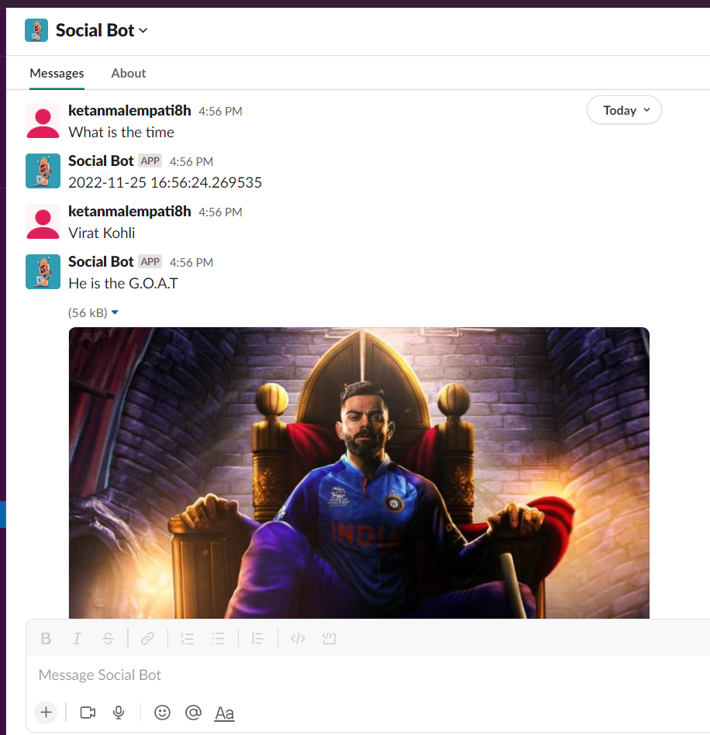
Single-Turn Conversations

Slide 5
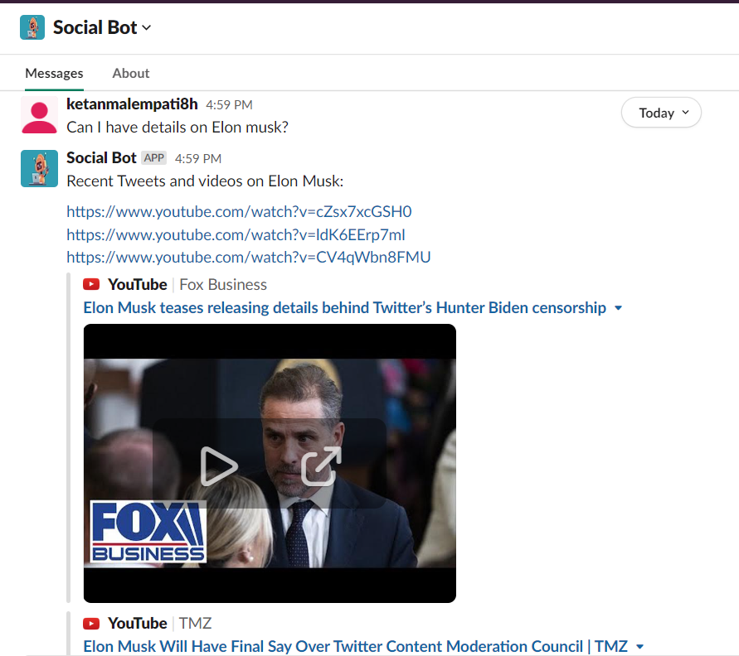
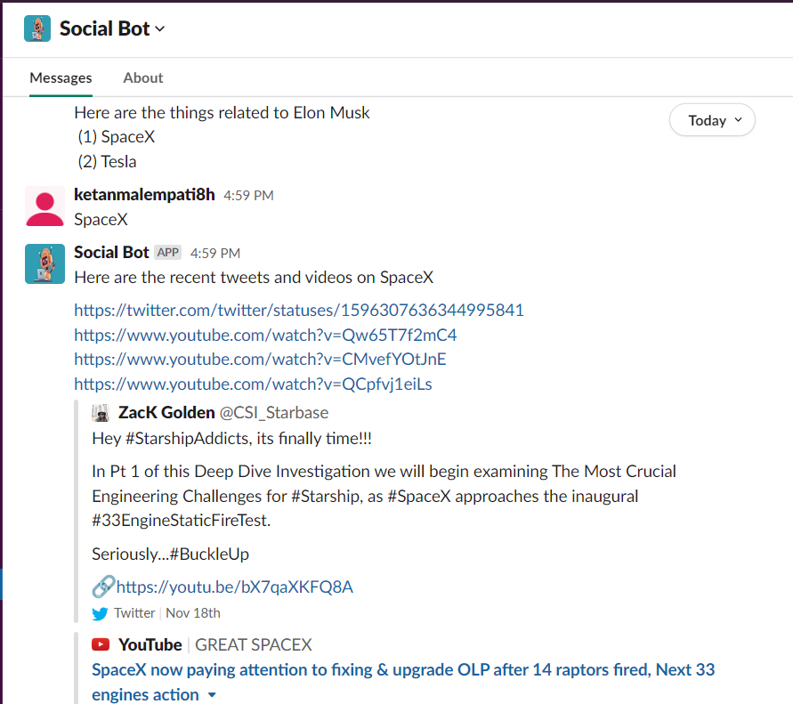
Multi-turn Conversations

Slide 6
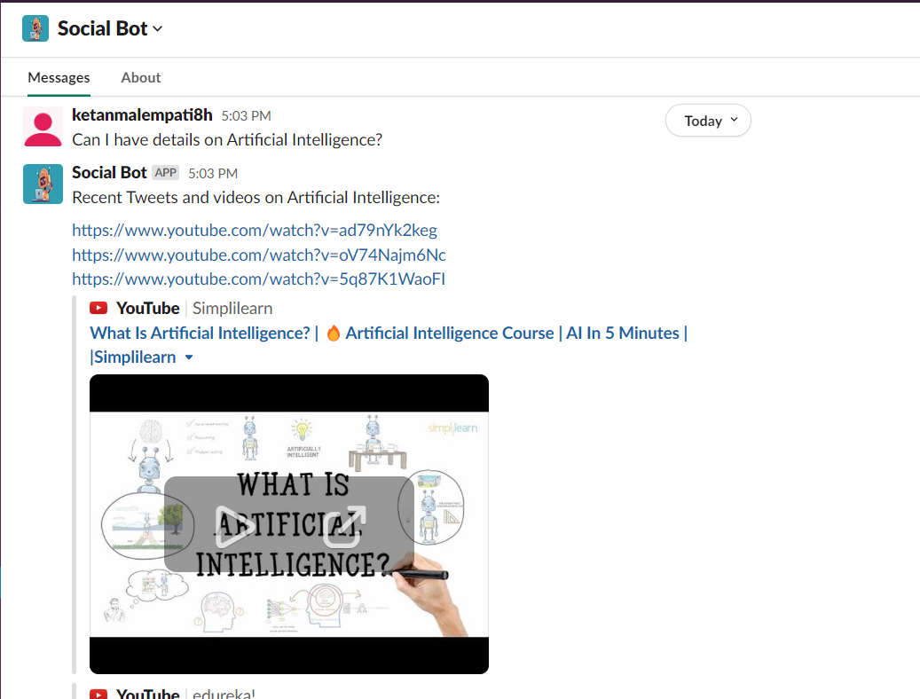
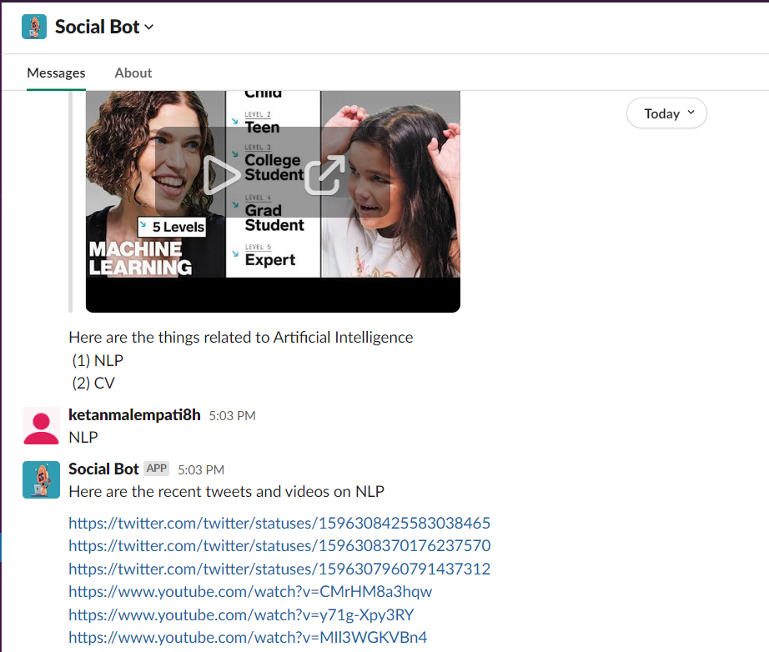

Slide 7
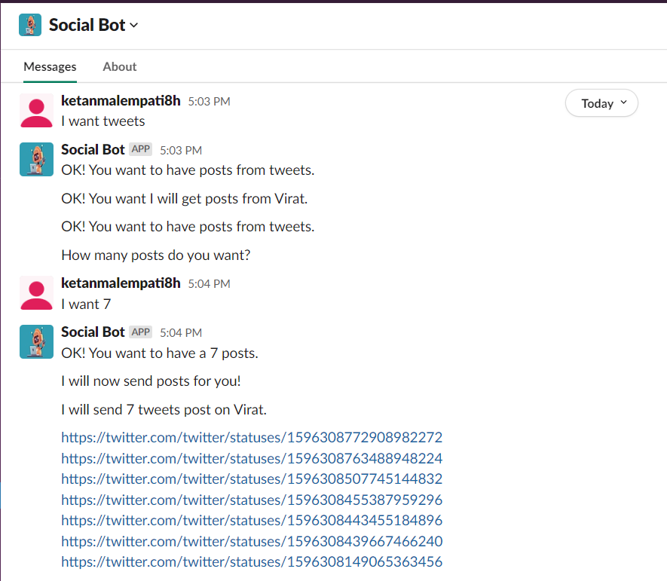
Slots filling conversation

Slide 8
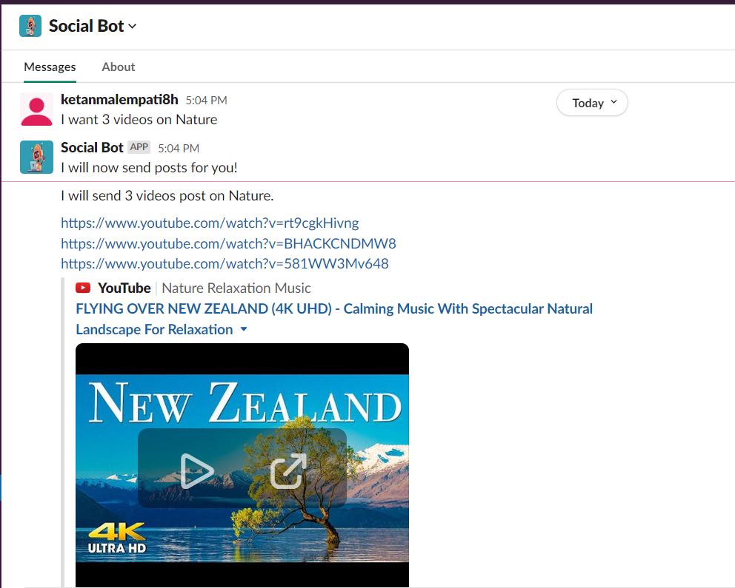

Slide 9
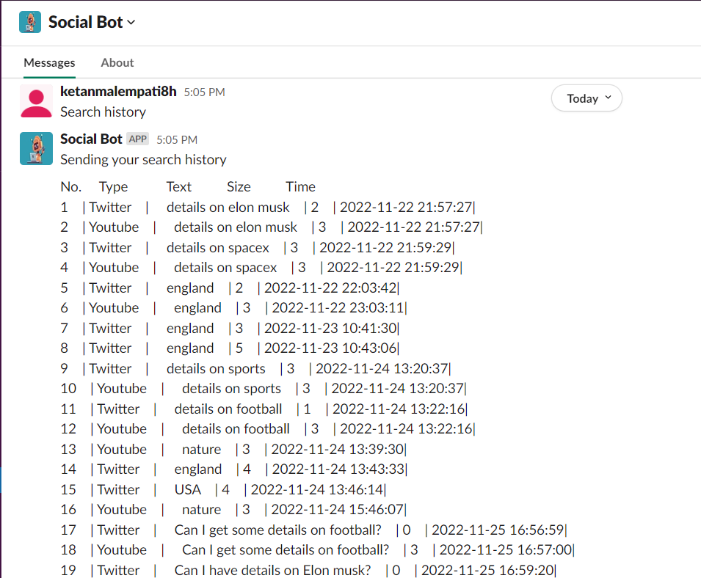
Database usage conversations

Slide 10
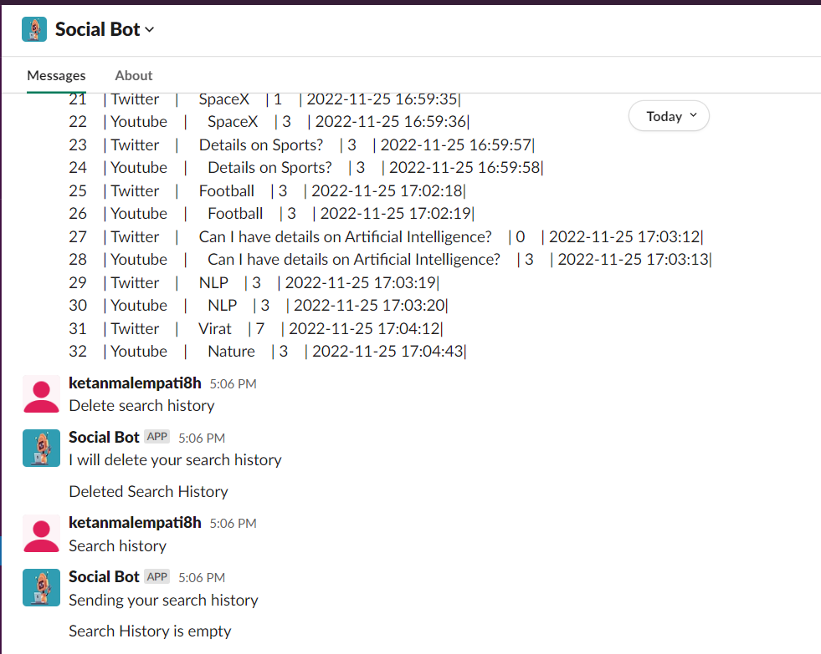

Slide 11
DEMO

Slide 12
Challenges faced
Named Entity detection was difficult.
Trying to run actions for the first time was very difficult as I made mistakes in port number.
Adding the bot to slack for a little tedious process.
FUTURE IMPROVEMENTS
Make it more generic to detect Proper Noun better.
Add more social media platforms.
Add Translations to other languages.
Add Feedback Form.

Slide 13
References
https://rasa.com/docs/rasa/installation/environment-set-up/
https://www.youtube.com/watch?v=2Qu4LCvB4bs&t=456s
https://github.com/RasaHQ/rasa-3.x-form-examples
https://www.youtube.com/watch?v=VcbfcsjBBIg&t=630s
https://www.youtube.com/watch?v=hIWnpyTWsLQ&t=1096s
https://www.youtube.com/watch?v=Ds8cB3LZwfU&t=799s
https://rasa.com/
https://github.com/RasaHQ/rasa-2.x-form-examples

Slide 14
Thank you

